Slide 1
Fake News Article Detection Using Stance Identification
Final Year Project 2017-18
Mentor- Prof. G.P.Biswas
By
Nandikonda Sharathchandra-14JE000443
Praveen Kurapati-14JE000486
Vikash Rajput-14JE000374
Parvin Mor-14JE000087

Slide 2
INTRODUCTION
News is an important source of information to the people.
With the advent of fake news being used to influence elections, the identification of false information has become an important task
However due to increasing amount of fake news in social media it had become a challenging aspect for traditional journalism.
It is defined as a made up story which is not true.
In this project we are focusing on analyzing the relationship between headline and body to classify it as a fake news.

Slide 3
WHAT DOES STANCE DETECTION HAVE TO DO WITH DETECTING FAKE NEWS?
Stance Detection solution allows a human to enter a claim or headline and retrieve the top articles that agree, disagree or discuss the claim/headline in question
It is possible to build a prototype “truth labeling” system from a “stance detection” system.
HOW?
If several high-credibility news outlets run stories that Disagree with a claim,the claim would be provisionally labeled as False
If a highly newsworthy claim (e.g. “British Prime Minister Resigns in Disgrace”) only appears in one very low-credibility news outlet, without any mention by high-credibility sources , the claim would be provisionally labeled as False.

Slide 4
Input A headline and a body text - either from the same news article or from two different articles.
Output
Classify the stance of the body text relative to the claim made in the headline into one of four categories:
Agrees: The body text agrees with the headline.
Disagrees: The body text disagrees with the headline.
Discusses: The body text discuss the same topic as the headline, but does not take a position
Unrelated: The body text discusses a different topic than the headline

Slide 5
Example
Headline | Robert Plant Ripped up $800M Led Zeppelin Reunion Contract
Unrelated | … Richard Branson’s Virgin Galactic is set to launch SpaceShipTwo today. ...
Agree | … Led Zeppelin’s Robert Plant turned down £500 MILLION to reform supergroup. ...
Disagree | ... No, Robert Plant did not rip up an $800 million deal to get Led Zeppelin back together. ...
Discuss | ... Robert Plant reportedly tore up an $800 million Led Zeppelin reunion deal. ...

Slide 6
Dataset Requirements:
1. Availability of both truthful and deceptive instances.
2. Verifiability of ‘ground truth’.
3. Homogeneity in lengths.
4. Homogeneity in writing matter.
5. Predefined timeframe.
6. The manner of delivery (e.g. humor, sensational, newsworthy).

Slide 7
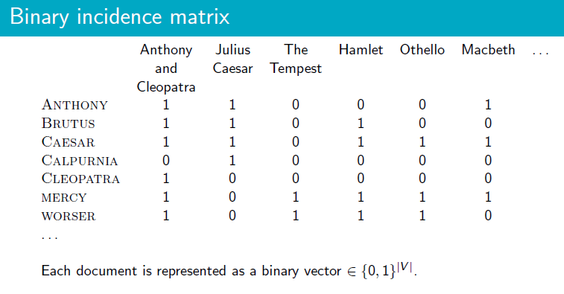
The vector space model

Slide 8
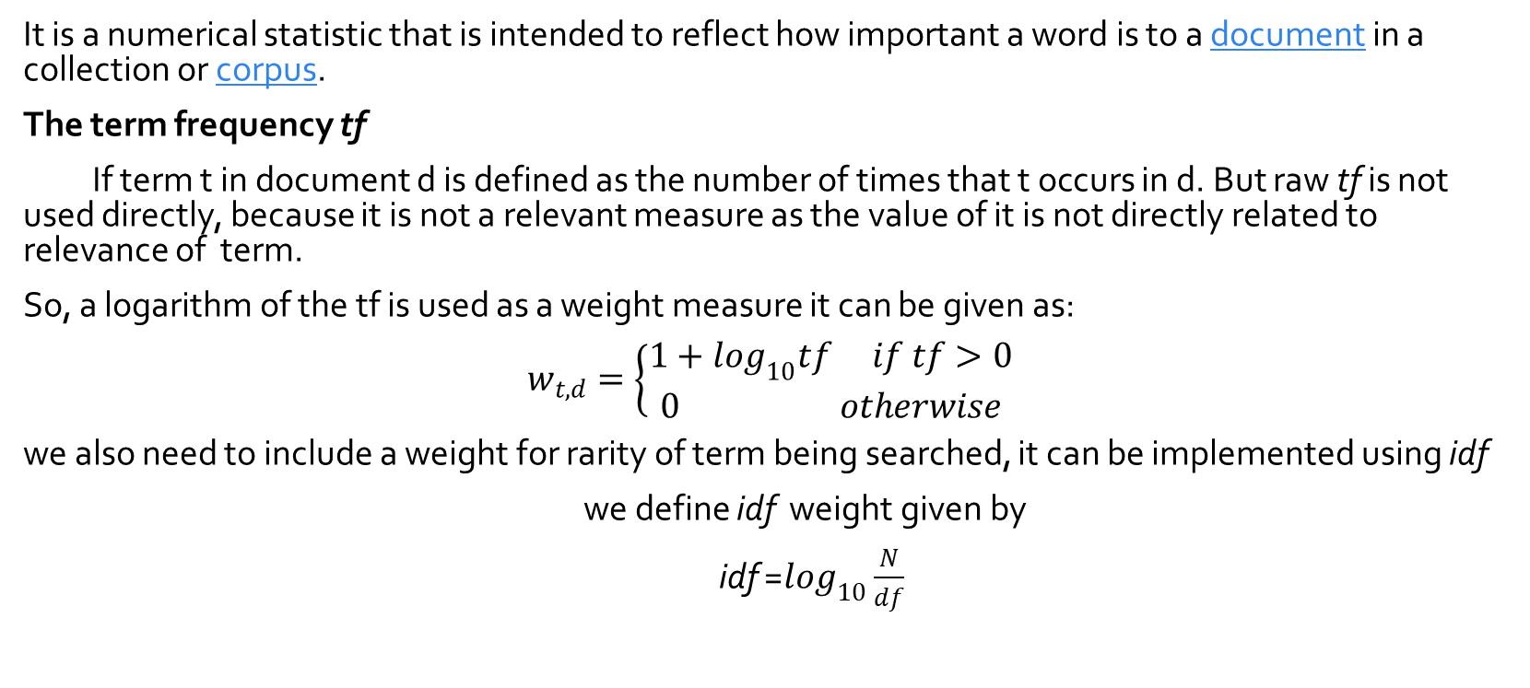
tf-idf
It is a numerical statistic that is intended to reflect how important a word is to a document in a collection or corpus.
The term frequency tf
If term t in document d is defined as the number of times that t occurs in d. But raw tf is not used directly, because it is not a relevant measure as the value of it is not directly related to relevance of term.
So, a logarithm of the tf is used as a weight measure it can be given as:
$$w_{t,d}=\left\{\begin{aligned}1+\log_{10}tf if tf>0 \\ 0 otherwise\end{aligned}\right.$$
we also need to include a weight for rarity of term being searched, it can be implemented using idf
we define idf weight given by
idf =$\log_{10}\frac{N}{df}$

Slide 9
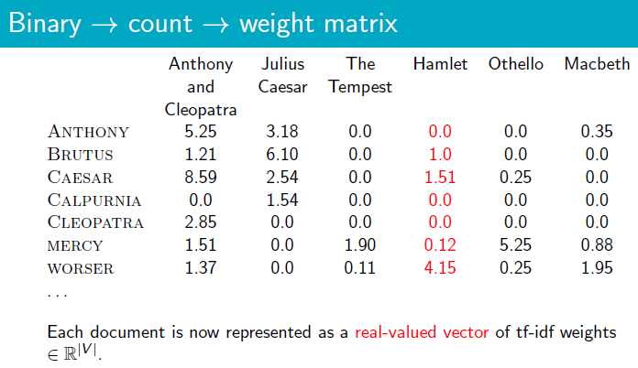
The vector space model and tf-idf

Slide 10
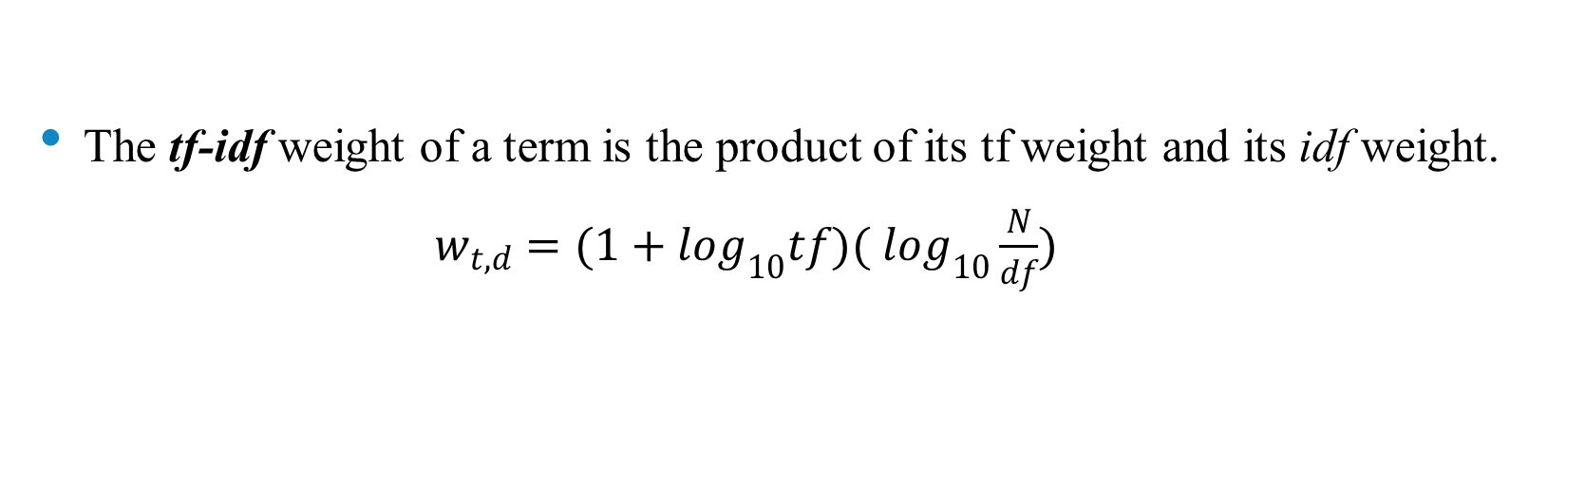
The tf-idf weight It increases with the number of occurrences within a document.(term frequency) increases with the rarity of the term in the collection. (inverse document frequency).
The tf-idf weight of a term is the product of its tf weight and its idf weight.
$w_{t,d}=(1+\log_{10}tf)( \log_{10}\frac{N}{df})$

Slide 11
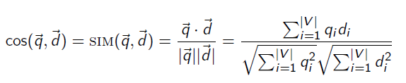
Cosine Similarity
Each document/ query can be given as vector of term with each value being tf-idf weight of term with document collection.
To find the similarity or relativity of query and document pair, we need a similarity measure. The cosine similarity is the best way to do it.
Normalization of each document is done to make it independent of size.

Slide 12
Implementation
Implemented in Python using Anaconda sofware.
The dataset was collected from fakenews.org
Dataset has two csv files
Each Contains pairs of headline and body text and appropriate class label
The data provided is (headline, body, stance)
stance is one of {unrelated, discuss, agree, disagree}.

Slide 13

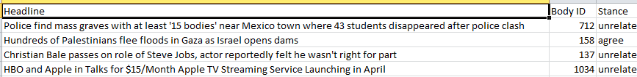
Dataset
train_bodies.csv
This file contains the body text of articles (the article Body column) with corresponding IDs (Body ID).
train_stances.csv This file contains the labeled stances (the Stance column) for pairs of article headlines (Headline) and article bodies (Body ID, referring to entries in train_bodies.csv).

Slide 14
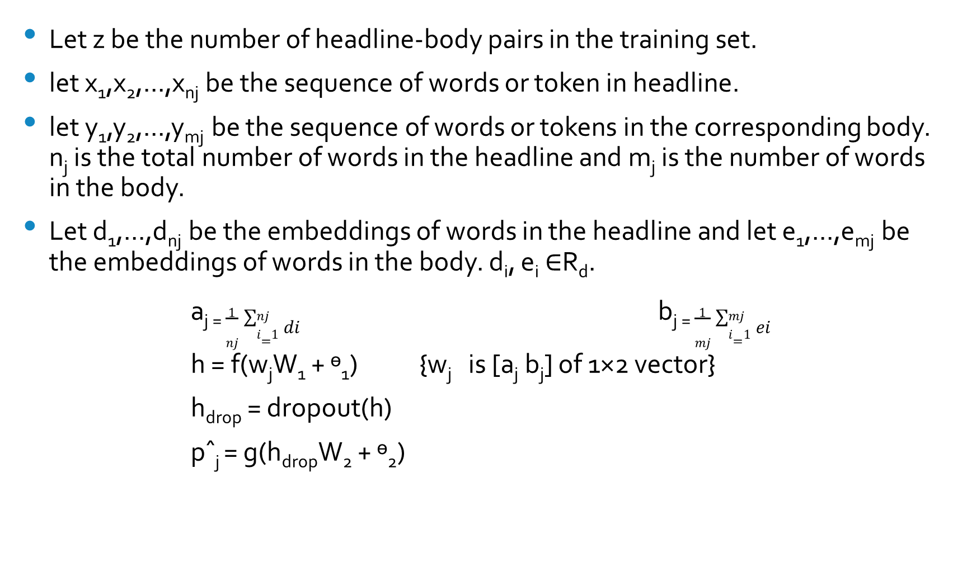
PROCEDURE
Let z be the number of headline-body pairs in the training set.
let x₁,x₂,...,x_{nj} be the sequence of words or token in headline.
let y₁,y₂,...,y_{mj} be the sequence of words or tokens in the corresponding body. n_{j} is the total number of words in the headline and m_{j} is the number of words in the body.
Let d₁,...,d_{nj} be the embeddings of words in the headline and let e₁,...,e_{mj} be the embeddings of words in the body. d_{i}, e_{i} ∈R_{d}.
a_{j =} $\frac{1}{nj}\sum_{i=1}^{nj}{di}$ b_{j =} $\frac{1}{mj}\sum_{i=1}^{mj}{ei}$
h = f(w_{j}W₁ + ᶱ₁) {w_{j} is [a_{j} b_{j}] of 1×2 vector}
h_{drop} = dropout(h)
pˆ_{j} = g(h_{drop}W₂ + ᶱ₂)

Slide 15
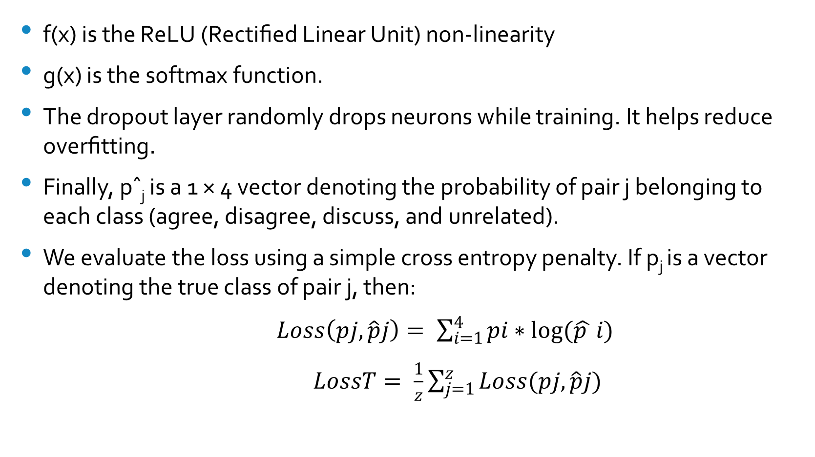
f(x) is the ReLU (Rectiﬁed Linear Unit) non-linearity
g(x) is the softmax function.
The dropout layer randomly drops neurons while training. It helps reduce overﬁtting.
Finally, pˆ_{j} is a 1 × 4 vector denoting the probability of pair j belonging to each class (agree, disagree, discuss, and unrelated).
We evaluate the loss using a simple cross entropy penalty. If p_{j} is a vector denoting the true class of pair j, then:
$Loss\left(pj,\hat{p}j\right)= \sum_{i=1}^{4}{pi∗log(\hat{p }}i)$
$LossT= \frac{1}{z}\sum_{j=1}^{z}{Loss(pj,\hat{p}j)}$

Slide 16

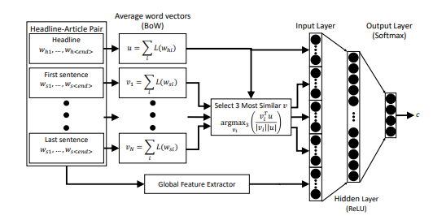
Training Model

Slide 17
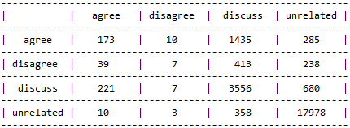
RESULT
Hold-Out Confusion Matrix
competition_dataset tuple:
(Headline) (Body ID) (stance)
Argentina's President Adopts Boy to End Werewolf Curse 37 unrelated

Slide 18
THANK YOU

